Slide 1
Core Philosophies of JIT (Just In Time)
Right quantity of goods
Simplicity
Continuous improvement
Visibility
Flexibility
JIT
Right place
JIT
Right time
Inappropriate processing
Overproduction
Transportation waste
Inventory waste
Waiting time
Waste of motion
Underutilization of employees
Defects
JIT
Eliminating waste

Slide 2
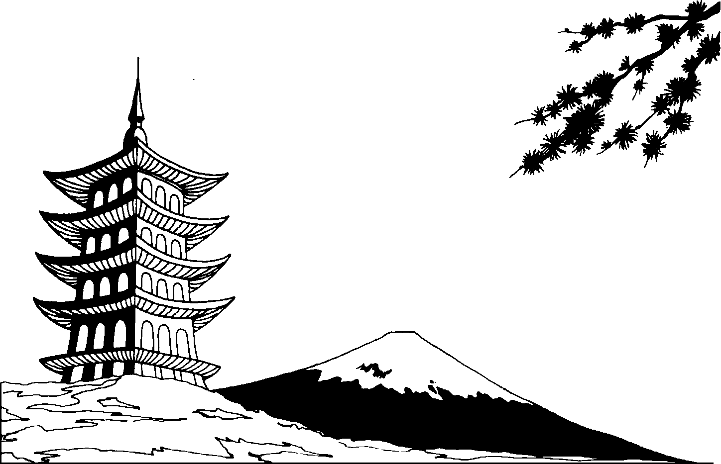
History of JIT (Just In Time)
It is a Japanese management philosophy.
It was first developed within the Toyota manufacturing plants.
Tajichi Ohno is “the father of JIT”.
It is an approach that focused on people, plants and systems.

Slide 3







The Kanban System
It is a scheduling system, which tells you what to produce, when to produce it, and how much to produce.
Ohno learned the Kanban (pull) system from in which , thereby creating an
. The empty space is a signal for . If an item was , there was no need to
replace it. When item quantities become , that is the signal for the stockers to order more goods from
their .

Slide 4


Advantages of JIT (Just In Time)
Reduce setup time
The flow of goods improves
Employees with multiple skills are used more efficiently
Production scheduling and work hour consistency synchronized with the demand
Supplier relationships
Supplies come in at regular intervals
Improved quality
Less pressure on inspection areas

Slide 5


Disadvantages of JIT (Just In Time)
No extra stock
Errors cannot be afforded on the production line since minimal raw material is kept
Material from the suppliers delayed production line stopped

Slide 6

Student Name: Roxana Lazar
Lecturer: Andrew Horan
Course Name: Print and Digital Media Technology Management
Year: 2
Submission Date: 3rd October 2014

